Slide 1
Responsive Design and Twitter Bootstrap
Kathy E. Gill
@kegill

Slide 2

Introductions
Who are we?
What do you do?
What do you want to do?
What tools or areas of web design interest you most?
About the class ….

Slide 3
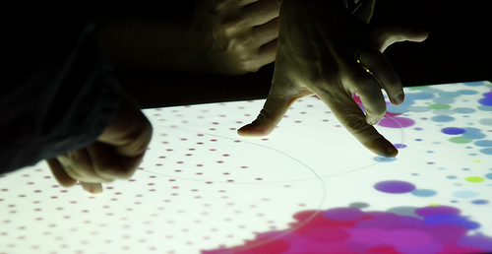
Design
What is it?

Slide 4
Concepts
Responsive Design
Frameworks
Open Source

Slide 5
Design is a process for developing solutions that effectively integrate task, context of use, and “user.”

Slide 6
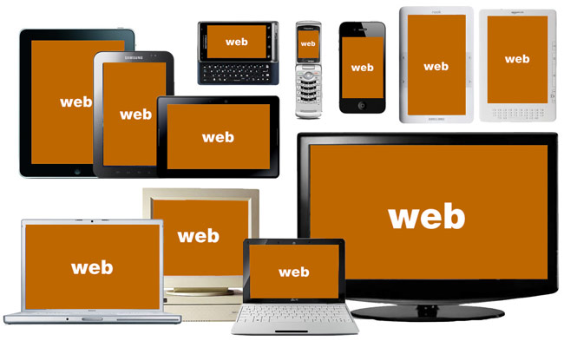
State of Today’s Web
Source: http://bradfrostweb.com/
Notes:
This is the challenge.
How do you design for all of this?
How do you manage the budget (staff, resources)?

Slide 7
51% of US mobile phones are smartphones
Source: http://www.comscore.com/Insights/Press_Releases/2013/4/comScore_Reports_February_2013_U.S._Smartphone_Subscriber_Market_Share

Slide 8
“Anyone who slaps a ‘This page is best viewed with browser X’ label on a web page appears to be yearning for the bad old days, before the web, when you had very little chance of reading a document written on another computer, another word processor, or another network.”
Tim Berners-Lee in Technology Review, July 1996

Slide 9
What is Responsive Web Design?
An approach to web design that provides an optimal viewing experience across a wide range of devices.
http://www.alistapart.com/articles/responsive-web-design/
Notes:
First introduced in 2009 by Ethan Marcotte who has also written a book with the same title.

Slide 10
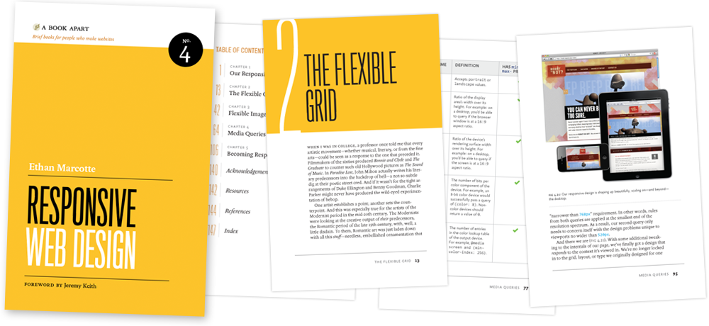
http://www.abookapart.com/products/responsive-web-design
Notes:
First introduced in 2009 by Ethan Marcotte who has also written a book with the same title.

Slide 11
Elements of RWD
Fluid Grid
Resizable Images
Media Queries
Notes:
First introduced in 2009 by Ethan Marcotte who has also written a book with the same title and which I also recommend.
I’ve spent the last two years learning about and really digging into responsive Web design and I’ve gotta say, It is the beginning of a new era in the Web.

Slide 12
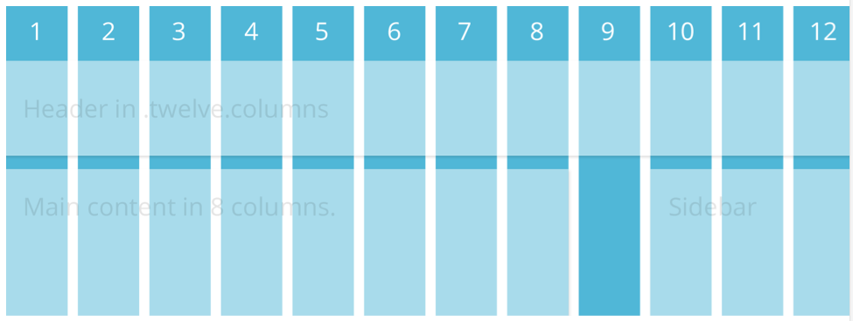
Grids

Slide 13
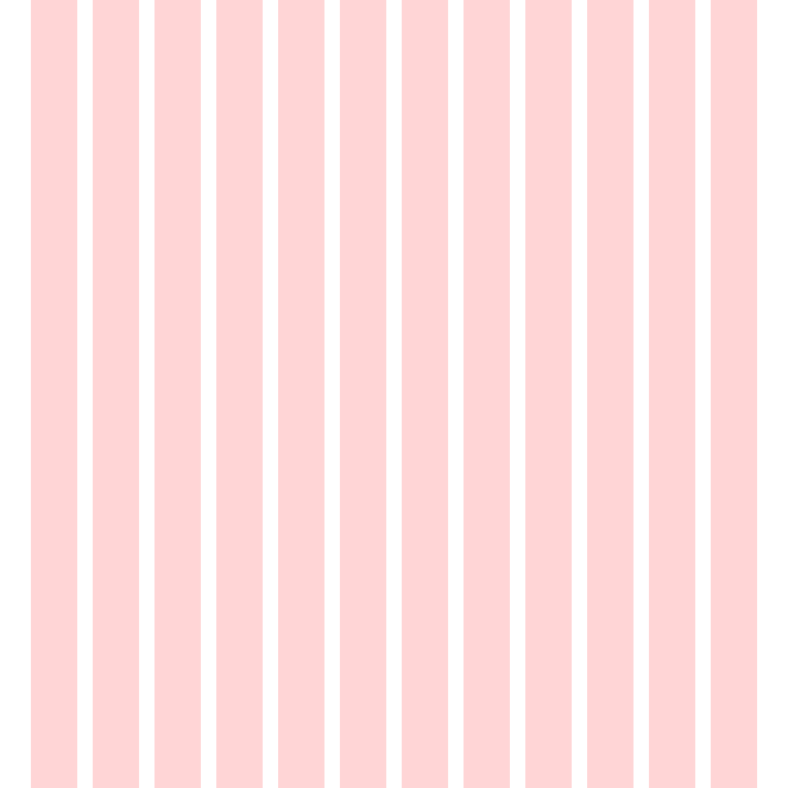

Slide 14
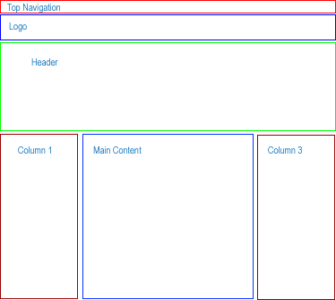
Grids /

Slide 15
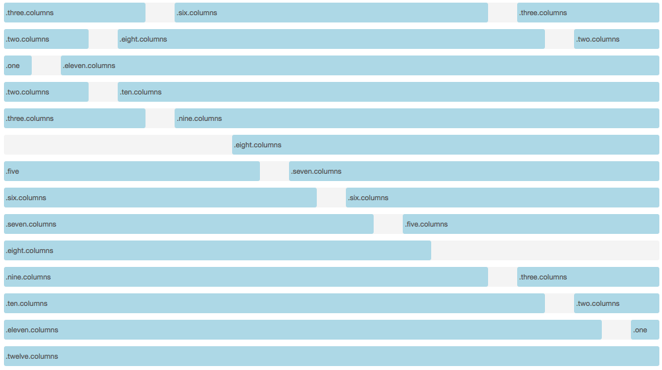
How do grid systems work?
Example based on Foundation Zurb Framework (http://foundation.zurb.com). A 12 column grid system

Slide 16
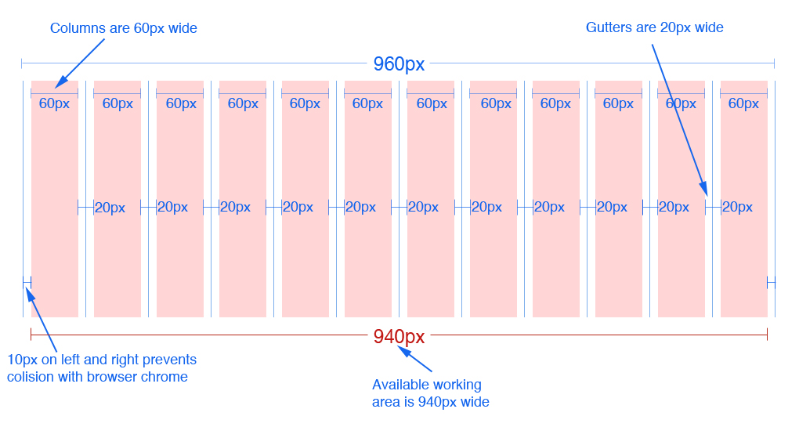
12 column version
12 column version
Source: 960.gs
Notes:
In the 16 column version each column is 40px wide. Everything else remains the same

Slide 17
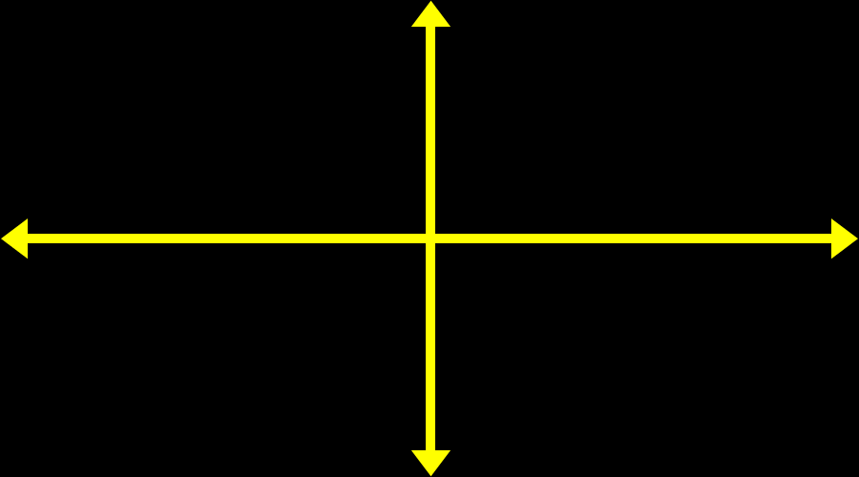
Resizable Images
img {
max-width: 100%;height: auto;}

Slide 18
Media Queries
A CSS3 module that renders web pages based on conditions such as screen resolution
Drafted in 2001 by the W3C
Became a recommended standard in June 2012
Source: Wikipedia.org
Notes:
First introduced in 2009 by Ethan Marcotte who has also written a book with the same title and which I also recommend.
I’ve spent the last two years learning about and really digging into responsive Web design and I’ve gotta say, It is the beginning of a new era in the Web.

Slide 19
Common Breakpoints
Label | Layout Width
Smartphones | 480px and below
Portrait Tables | 480px to 768px
Landscape Tablets | 768px to 940px
Default | 940px and up
Large Screens | 1210px and up

Slide 20
Advantages & Disadvantages
Advantages | Disadvantages
User Experience (UX) | User Experience/Load Time
Analytics | No linking
Sharing/Linking | SEO
SEO | Development
Development | Design
Maintenance
Source: http://www.seomoz.org/

Slide 21
Frameworks
Project requirements determine the framework
Fluid Grid System
Responsiveness a plus
Offer more than just a grid (pre-defined styles for typography, tables, buttons, navigation, forms elements, etc.)

Slide 22
Frameworks
Great documentation
Maintained regularly by the community or creator
Open Source (free)

Slide 23
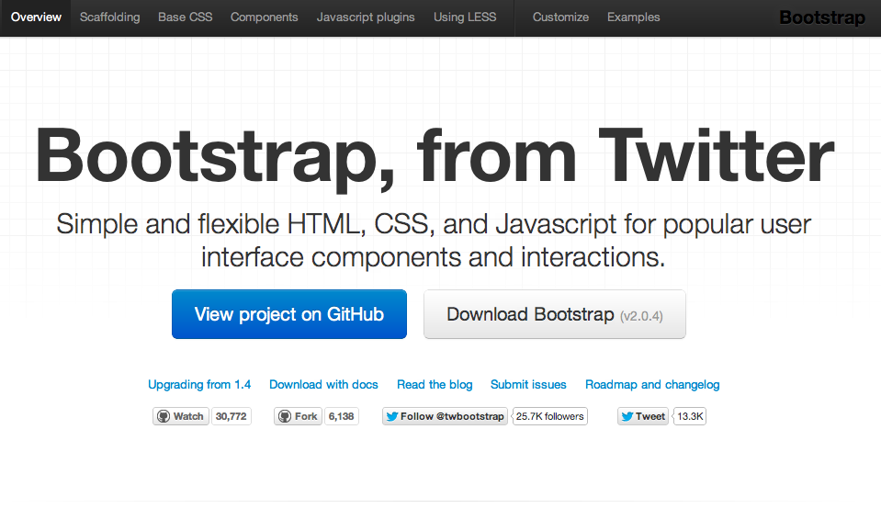

Slide 24
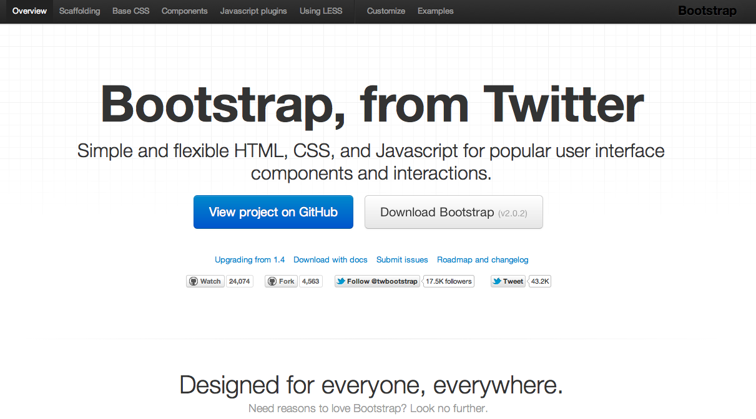
What
http://twitter.github.com/bootstrap/

Slide 25
Twitter Bootstrap
A freely available design framework for websites and web applications
Based upon HTML5, CSS and JavaScript
Supports all major browsers (even IE7!)
Released on GitHub in August 2011

Slide 26
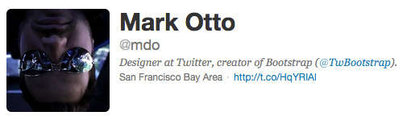
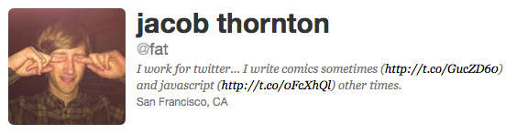
Created By

Slide 27
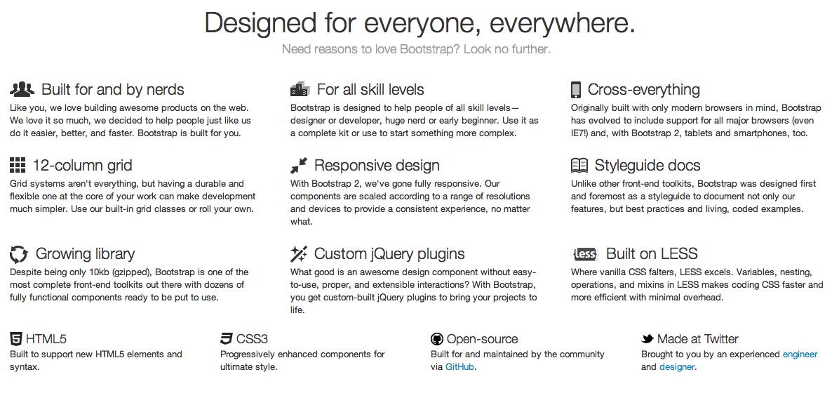
Why
Reason #1: Rich Features

Slide 28
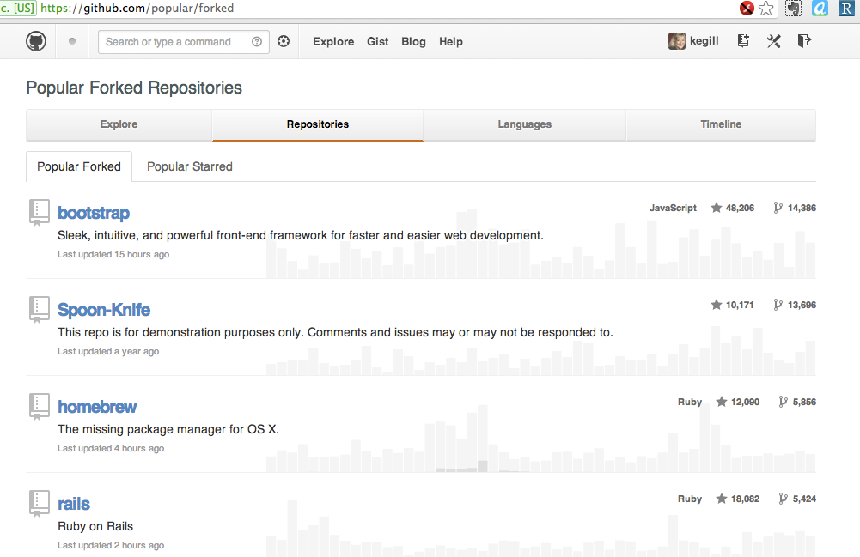
Why
Reason #2: Popularity

Slide 29



Why
Reason #3: Browser Support
Also MSIE and Opera

Slide 30
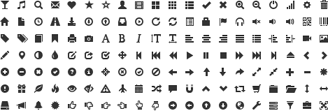
Why
Reason #4: Glyph Icon Set

Slide 31
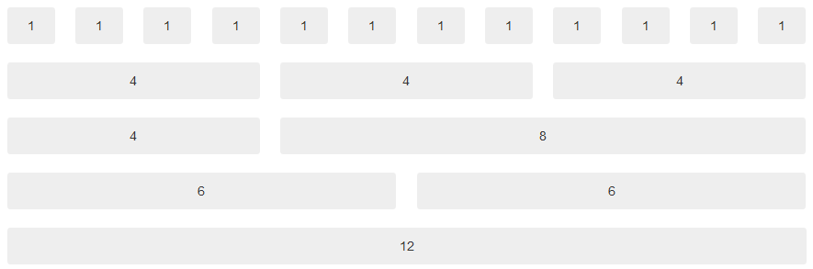
Why
Reason #5: Grid System
960 Grid System http://960.gs/
Blue Print CSS http://www.blueprintcss.org/
Golden Grid System http://goldengridsystem.com/
Notes:
Bootstrap is using a grid system base on 12 columns.
What is a grid system? A grid system is a way to create a solid foundation to build your project on.
If you want your web application to have a left navigation you could design your HTML using row number 3
If you do not want any navigation and you want your content to be as wide as possible then you could use row number 5
This grid design was popularized by 960 grid system http://960.gs and BluePrint http://www.blueprintcss.org

Slide 32

Why
Reason #6: Components
Buttons:
Tabs:
Breadcrumb:
Pagination:
Alerts:
Progress bar:
Notes:
Here is a list of some of the CSS component available. There are dozens of them available with bootstrap.

Slide 33
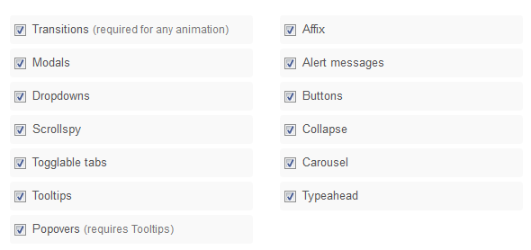
Why
Reason #7: Javascript/jQuery
Notes:
Bootstrap gives life to its UI by using Jquery plugins.

Slide 34
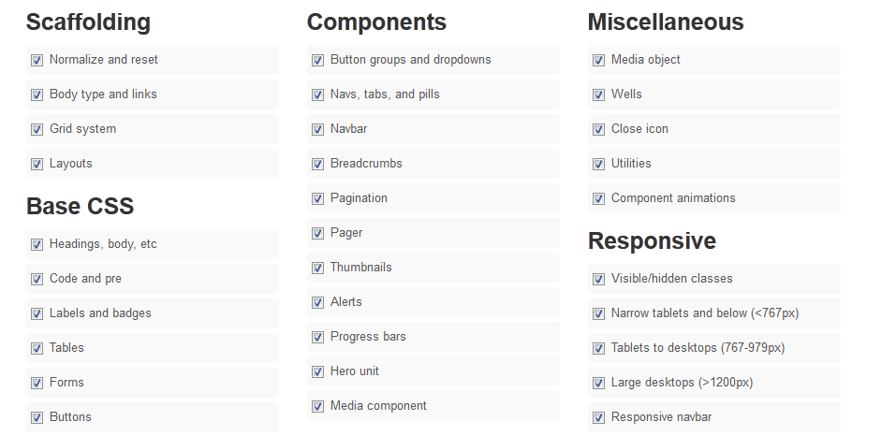
Why
Reason #8: Customization
Notes:
Bootstrap provides a web-based customizer that allow you to generate a CSS file based on your specific needs.

Slide 35
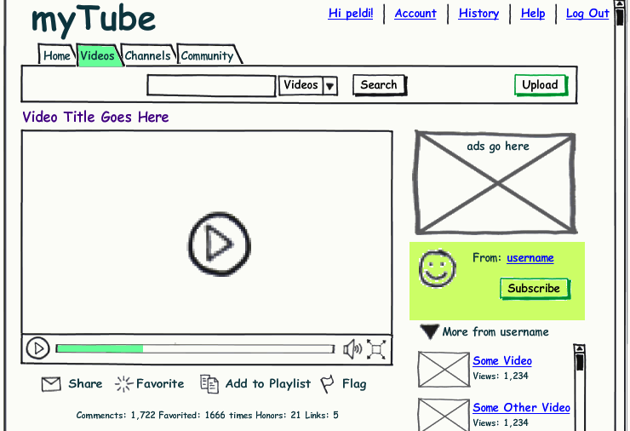
Why
Reason #9: Live Mock-Ups

Slide 36
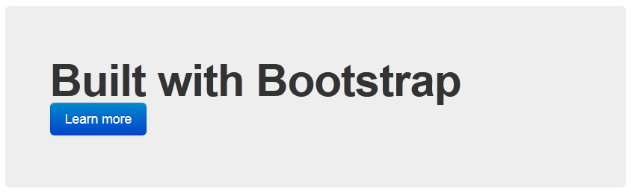

Slide 37

How
Download Bootstrap and inline text editor
Install text editor
Extract the bootstrap files in to your project folder
Download example html file and save it as index.html in the project folder

Slide 38
Do websites need to look exactly the same in every browser?
http://dowebsitesneedtolookexactlythesameineverybrowser.com/

Slide 39
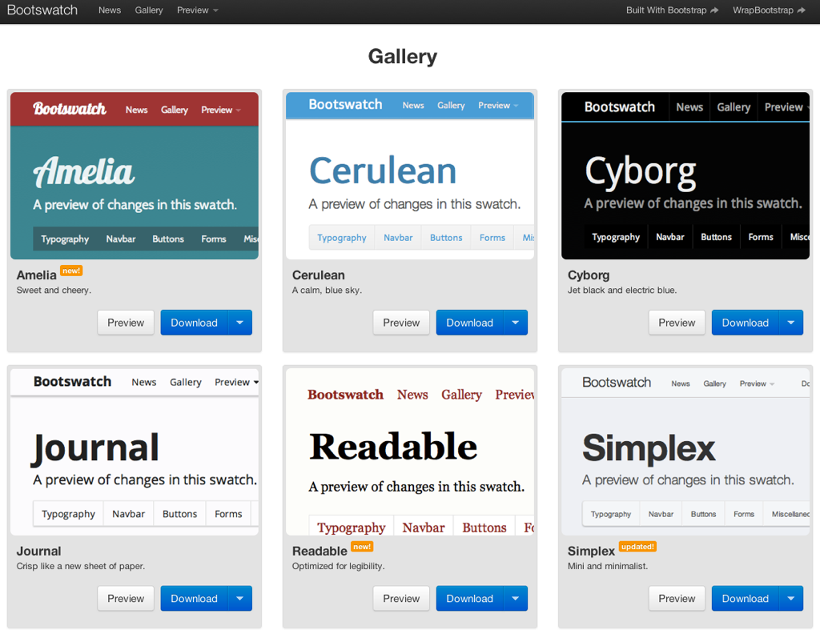
Resources
http://bootswatch.com/

Slide 40
Thanks!
Kathy E Gill
@kegill
Slideshare.net/kegill
Creative Commons License / share-and-share alike / attribution / non-commercial

